Slide 1


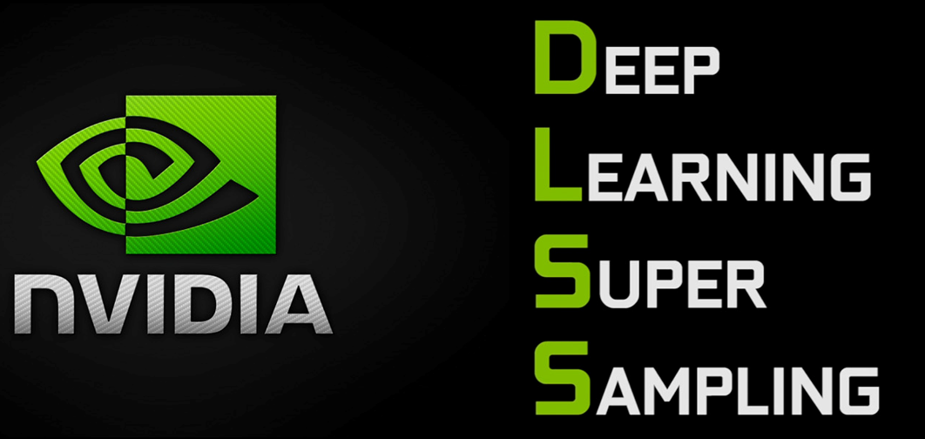
Niagara Particle System
Nanite Virtualized Geometry
Lumen Global Illumination and Reflections
DLSS Frame Generation
DLSS Ray Reconstruction
DLSS Super Resolution
Deep Learning Anti-Aliasing

Slide 2

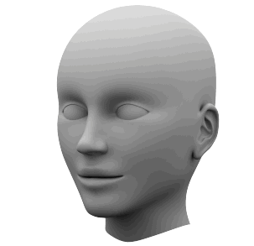

Wind physical effect trajectory will bypass the module
Wind physical effect trajectory will bypass the module
Snow particle effect trajectory will pass thought the module directly
Snow particle effect trajectory will “interact” with the module, some snow follow the wind trajectory, some snow goes higher some snow stick on the model
Without Niagara particle system
With Niagara particle system

Slide 3


Illumination Source
Illumination Source
Illumination Source
1060
3060
Light trajectory
Light trajectory
Light trajectory
Normal Illumination Solution
Lumen Global Illumination and Reflections in low performance GPU
Lumen Global Illumination and Reflections in high performance GPU

Slide 4
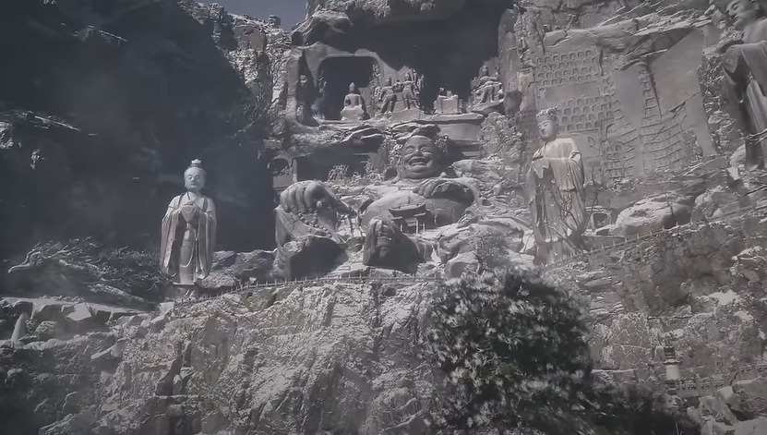
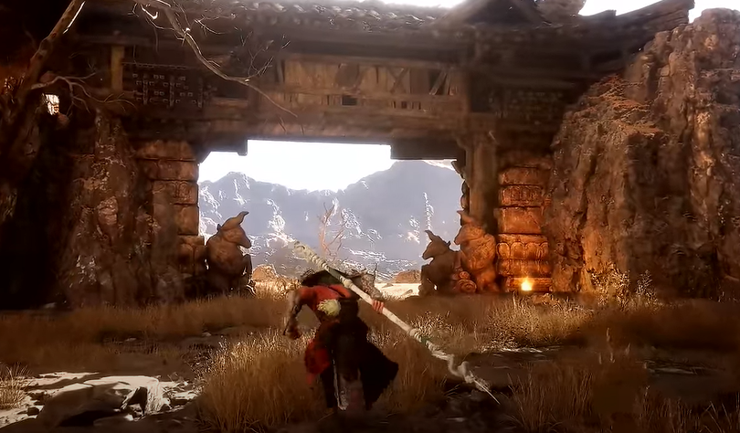
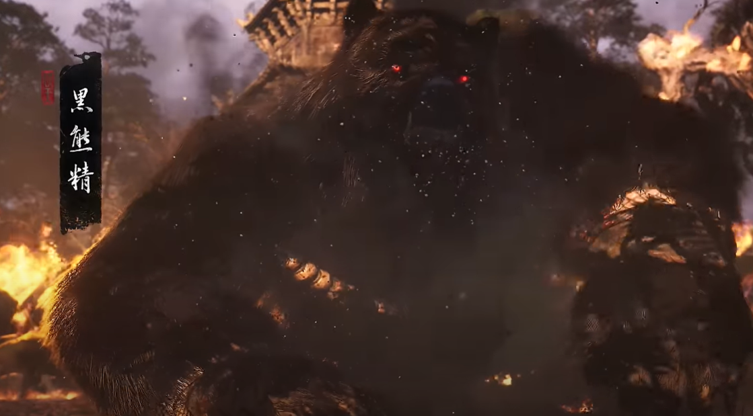
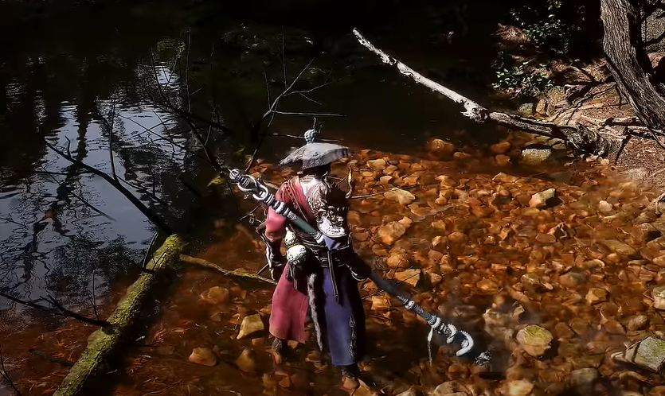
Dynamic Environmental Effects: Snow
Magic and Spell Effects
Explosions and Debris
Fluid Simulations

Slide 5
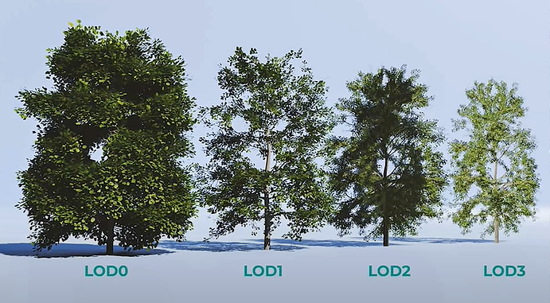
With UE5 Nanite automatically LOD, the engine will auto generate many different LOD based on the environment, camera view distance and convert them smoothly
Without Automatic Level of Detail, the developers need to build 4 different model manually

Slide 6
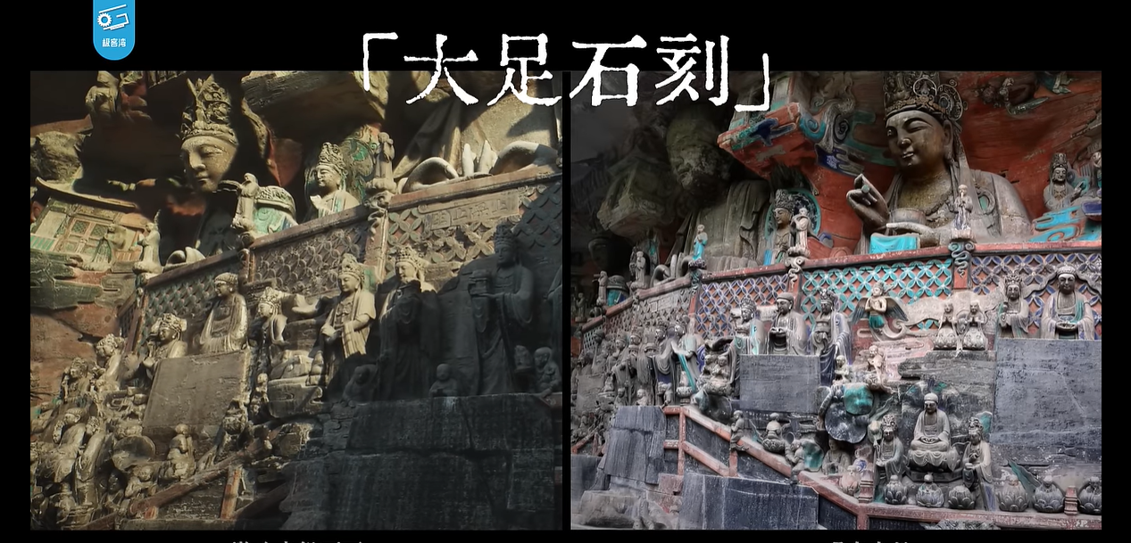
Photorealistic Environments in Game VS Real World Photo

Slide 7
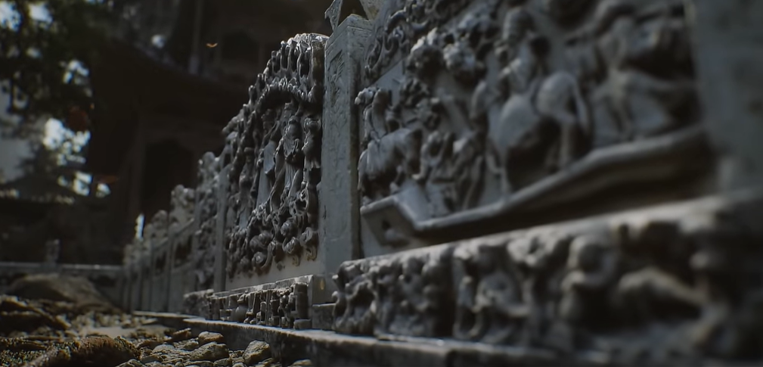
Complex Architectural Visualizations

Slide 8
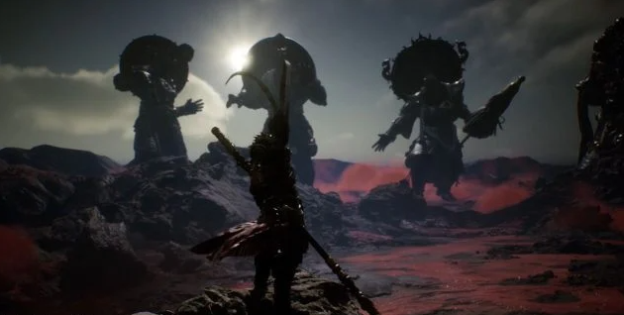
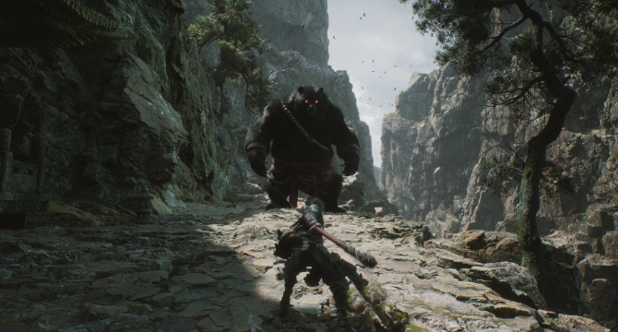
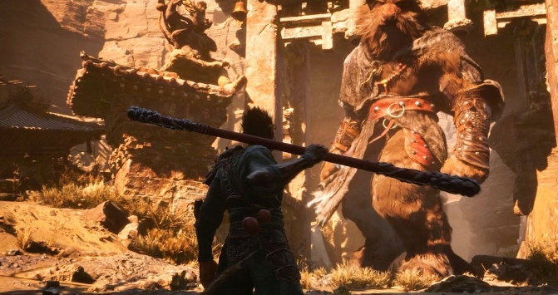
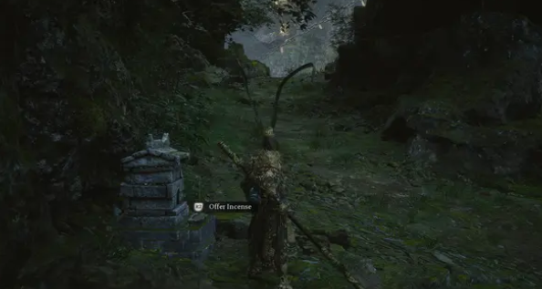
Dawn Time
Morning
Afternoon
Hight with moon light

Slide 9
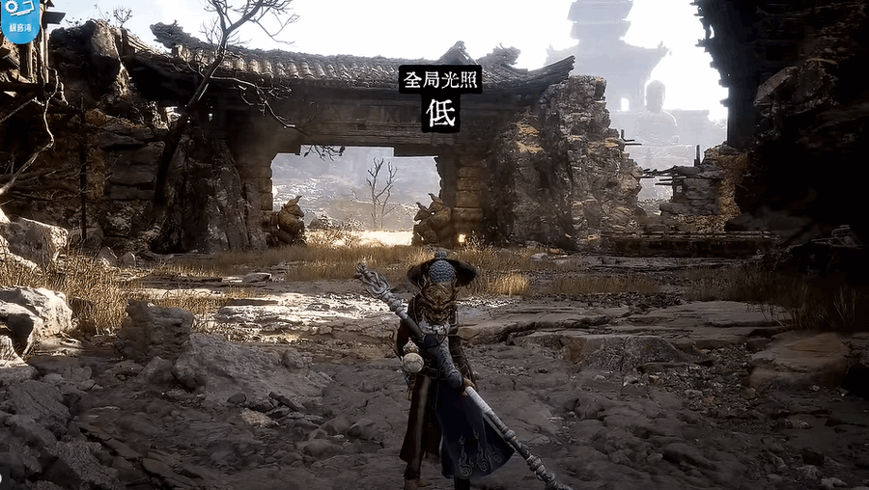
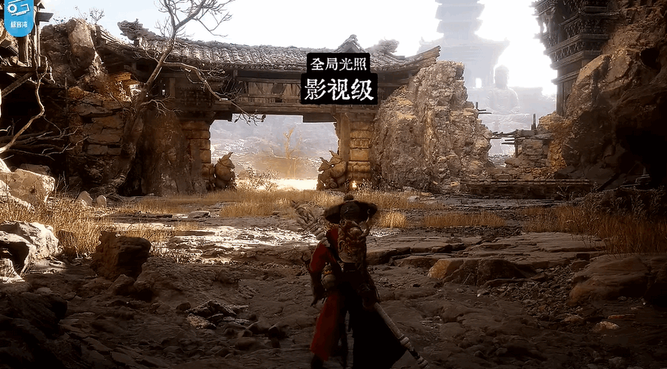
Lumen Global Illumination: Low
Lumen Global Illumination: Highest

Slide 10

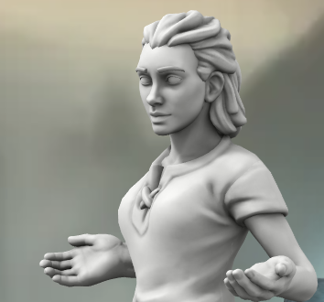
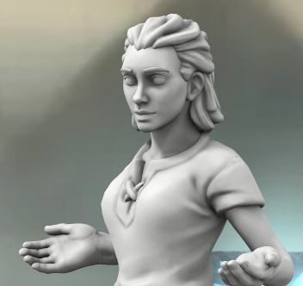
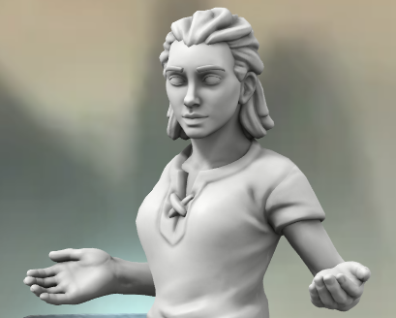
Nvidia DLSS AI Frame Generator
Frame Analysis and Machine learning
Insert AI generated transition frame
120 FPS Game display with DLSS AI assistance function
GPU Generated Frame-0
AI Generated Frame-0.5
GPU Generated Frame-1
60 FPS Game display without DLSS AI assistance function

Slide 11
Illumination Source
Illumination Source
Nvidia DLSS AI Ray Reconstruction
Insert AI generated diffuse reflection light trajectories
Light trajectory
Light trajectory
Graphic Card Without DLSS AI Ray Reconstruction
Graphic Card With DLSS AI Ray Reconstruction

